Slide 1
The Battle of Neighborhood

Slide 2
Introduction
This project is taking a consideration that there aren’t enough Indian restaurants in Toronto, Canada.
The Goal of this project is to find out, from the eyes of an entrepreneur, which location would be suitable to open an Indian Restaurant.

Slide 3
Data
We will be needing:
● List of neighborhoods in Toronto, Canada
● Latitude and Longitude of these neighborhoods
● Venue data related to Indian restaurants. This will help us find neighborhoods that are more suitable to open an Indian Restaurant.

Slide 4
Methodology
Extracting list of neighborhoods in Toronto, Canada.
get Restaurants coordinates to utilize Foursquare to pull the list of venue near these neighborhoods.
use Foursquare API to pull the list of top 100 venues within 500m radius
analyze each neighborhood by grouping the rows by neighbourhood and taking the mean on the frequency of occurrence of each venue category
performed the clustering method by using k-means clustering.

Slide 5
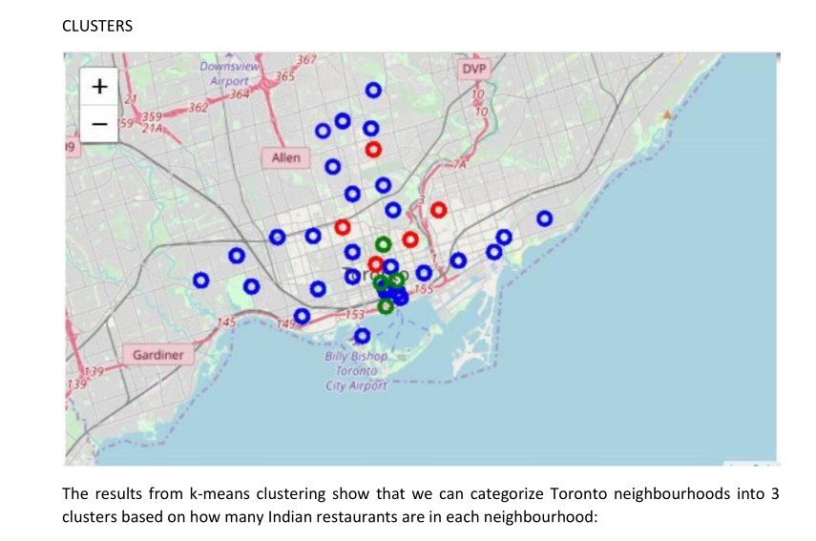
Results

Slide 6
Conclusion
Looking at nearby venues it seems cluster 0 might be a good location as there are not a lot of Indian
restaurants in these areas. Therefore, this project recommends the entrepreneur to open an
authentic Indian restaurant in these locations.

